Slide 1
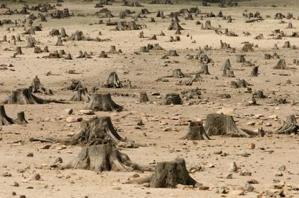
ENVIRONMENTAL GEOGRAPHY

Slide 2
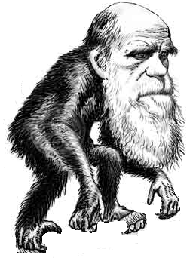
The goal of education
Knowledge
Old school
New school
Known knowledge
Unknown knowledge
Get to know what is already known
Think critically
CREATIVITY,
INNOVATION,
DISCOVERY,
SUCCESS
HOW?
Time

Slide 3
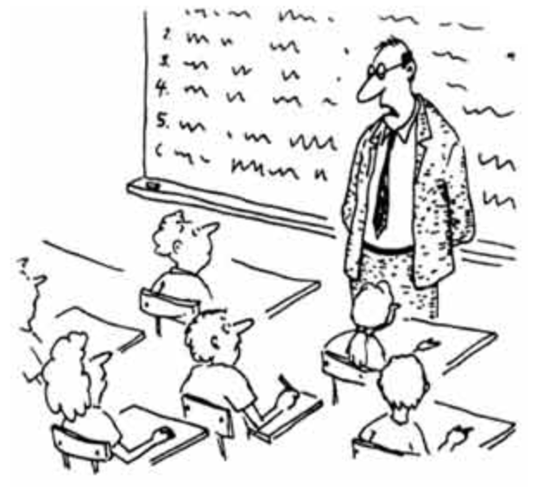


A problem with higher education
Information
Thinking
Memorizing
CREATIVITY, INNOVATION, DISCOVERY, SUCCESS
Notes:
Articulate information to make decisions. And for that you need thinking

Slide 4
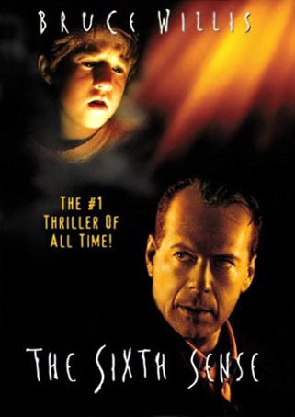
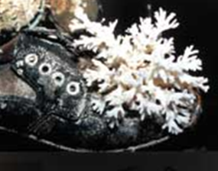
What is there in this movie for us to learn?
Critical observation:
Let you see new patterns where others see just data
This is key to new discoveries
Solve mystery about how corals colonized the Eastern Pacific
Interpretation:
All you know is your interpretation of reality
With the right elements, we can change the way we see things
Re-evolution of science
Change view on niche theory

Slide 5
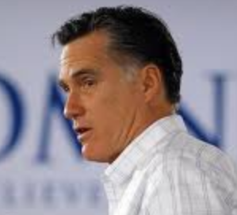
The effect of thinking
There needs to be some degree of government oversight
Freedom for competition is the key to the American dream
Who wants it?
The American Dream:
Large house
Nice car
Pretty wife
…
…
Behavioral economics
Charm
Psychological projection, Sigmund Freud
Optimism bias: “the demonstrated systematic tendency for people to be overly optimistic about the outcome of planned actions”
WINNERS
LOSERS
In the USA, 1% of the population has the same wealth as the remaining 99%
Six people in the Walton Family have as much money as 90 million Americans
Realistically, how many can get it?
The winners will take it all
CRITICAL THINKING

Slide 6
THINKING
Interpretation
/
opinion
Critical observation

Slide 7
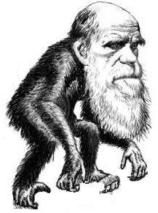
How to foster critical thinking and rational or novel interpretation of information?
We have a choice:
Known knowledge
Old school
New school
Unknown knowledge
Knowledge
Time
We try my method
To appreciate how people have reached novel knowledge in the past
All lectures are documented with actual data
Lectures
Before each class students will pair and talk about the topic of the prior class. Expect to be asked to report your discussion to the entire class.
During the course, at least three misleading or false or non-sense statements will be made, who finds them will get extra credit.
Class participation and discussion
Final project
Hands on practice of concepts

Slide 8
Where is the thinking?
There is, however, a catch
You need to talk.
We need to hear your thoughts
Has to be graded
You have to think what you say
It takes this pressure out
x
Concept reinforcement
Notes:
Articulate information to make decisions. And for that you need thinking. How are we to foster your chances of success, if all we teach you is to learn what make other people successful?

Slide 9
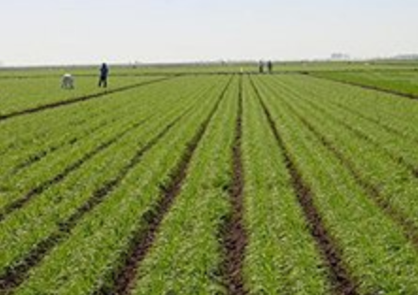
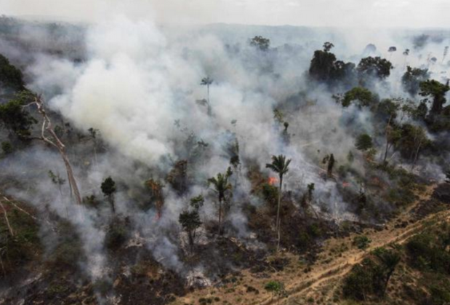
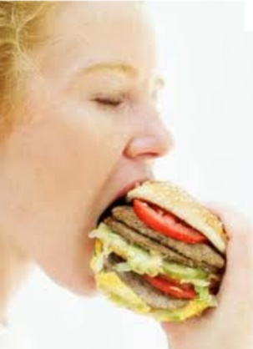
COURSE: ENVIRONMENTAL GEOGRAPHY
1. Lectures
2. Group research
3. Final film showcase
4. Extinction presentation
How?
What is happening to the world of biodiversity
Why?
What are we doing about it and is it working?
Can we continue along this cycle and can the Earth support us?

Slide 10
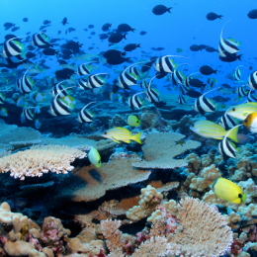
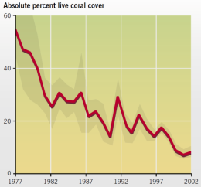
Final Project: choose to work on something useful!
Fragile
(e.g. Obama, Trump, climate change)
Top down solutions
Long-lasting but difficult
Communication
Political will
Bottom up solutions
Conservation policies
Public support
How to reverse this trend?

Slide 11
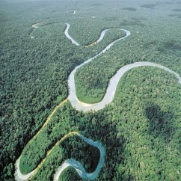
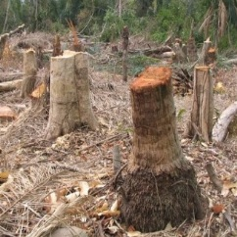
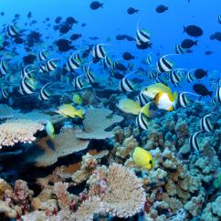
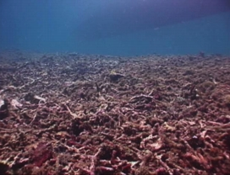
…the ultimate sacrifice…
EXTINCTION
Creative Commons Photos by Neil Howard, Flickr
Notes:
We are not cutting any slag to these poor species and ecosystems
5:19min we end up with systems that cannot return to their original states even if the stressors are removed.
5:45min Even now in the first world the thing is turning scary. For instance in the US 50 million people are suffering hunger or at risk of it. In Countries from africa and asia and the southpacific the situation is truly scary.
6:30 min today about 1 billion people, 20% of the world’s human population live near environments that are so deteriorated that basic food supply to humanity is not ensured anymore. The situation is even more critical when you consider future scenarios of clean water supply.
7:05 min Those statisitics are just sad…how, we, as a developed and smart’ species are letting this to happen.

Slide 12
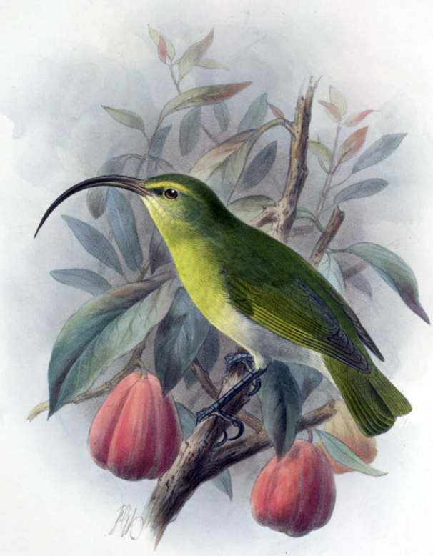
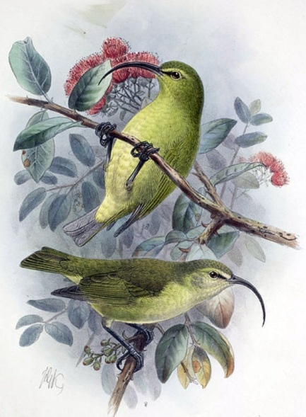
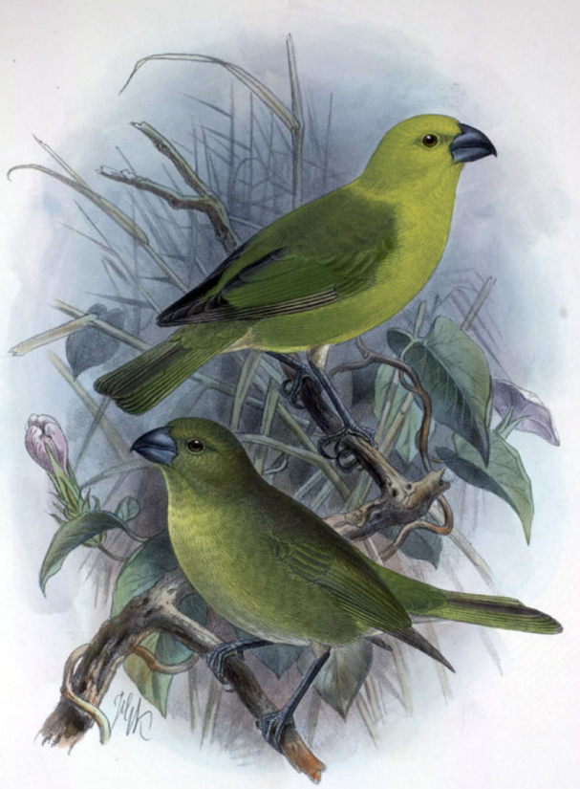
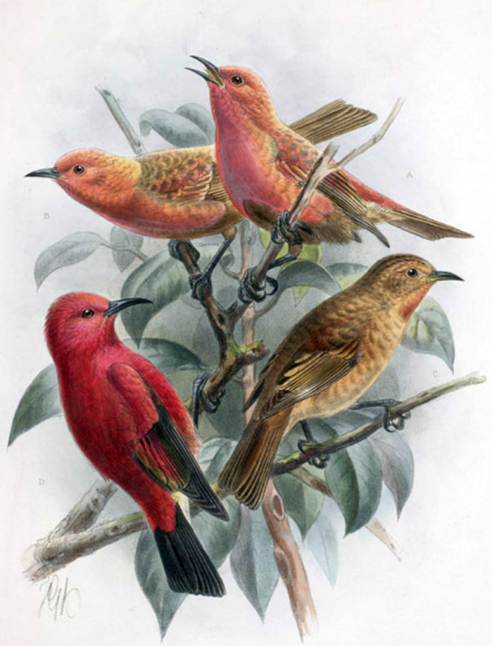
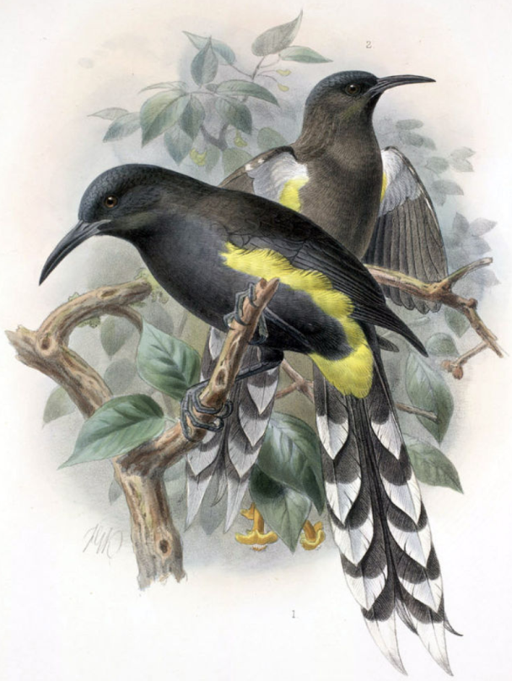
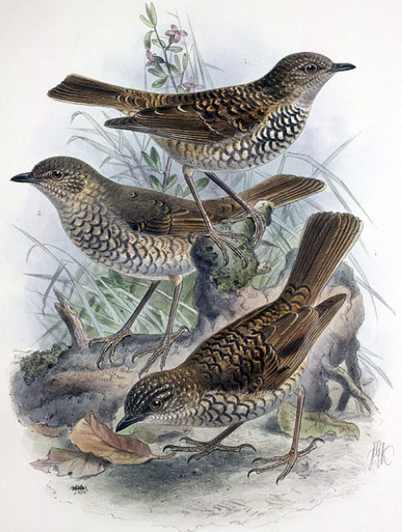
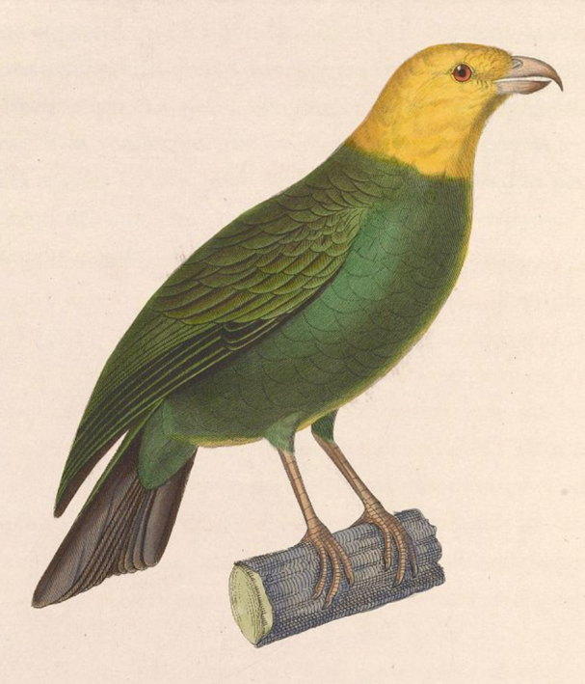
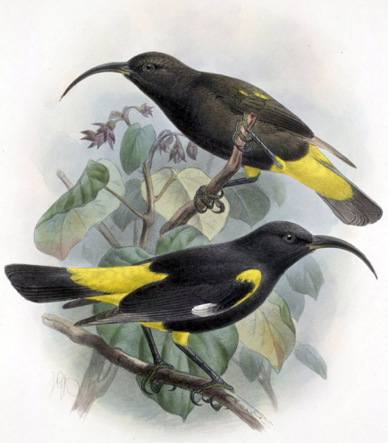
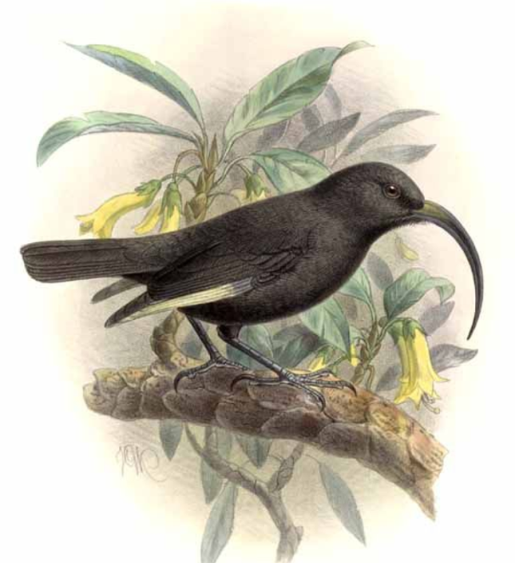
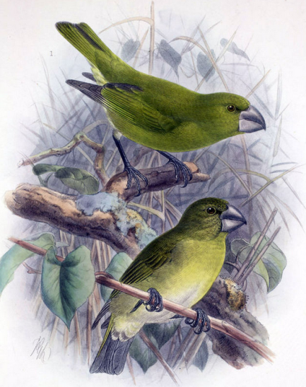
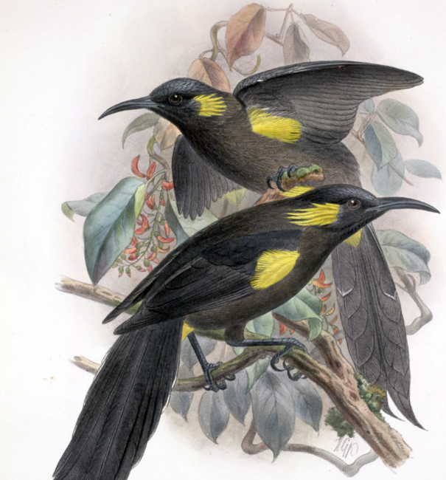
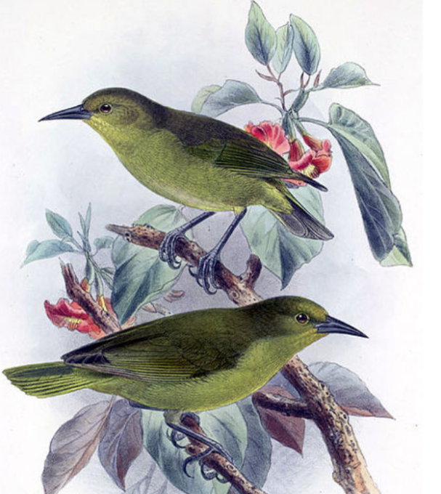
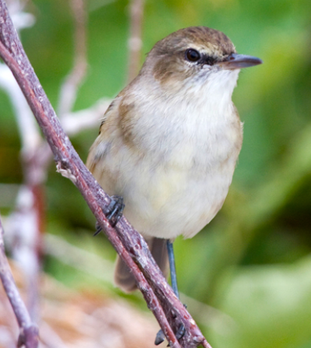
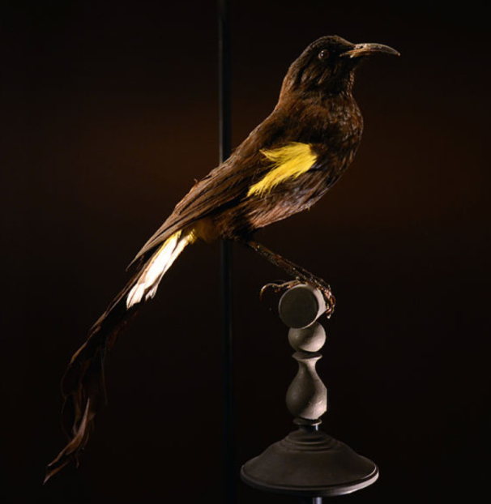
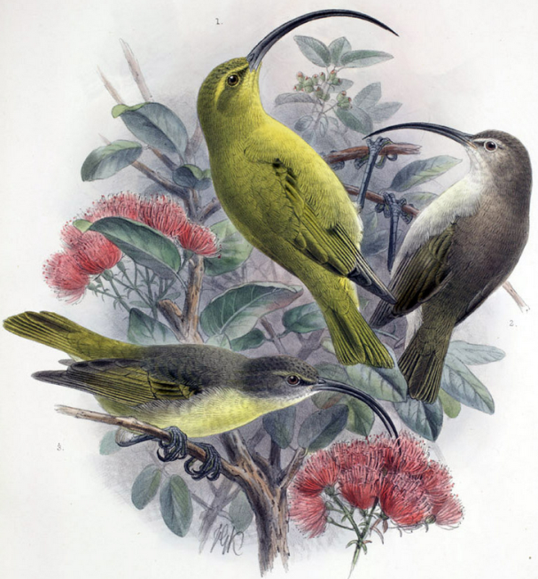
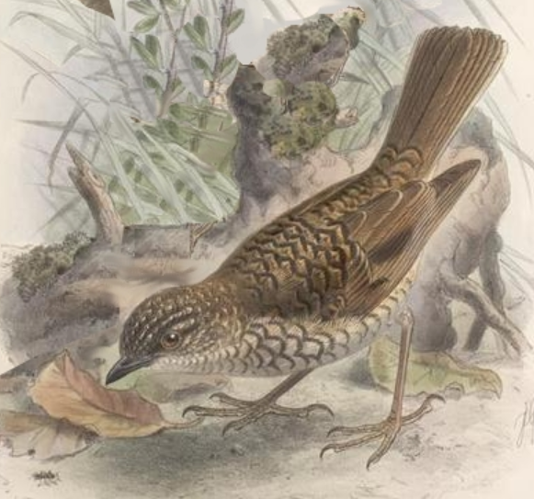
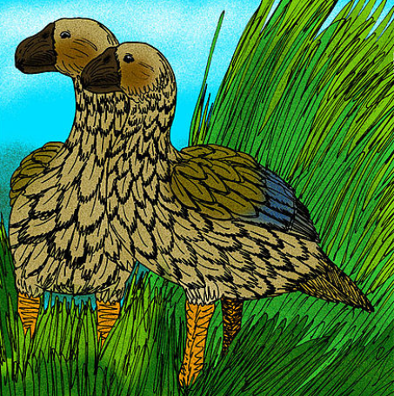
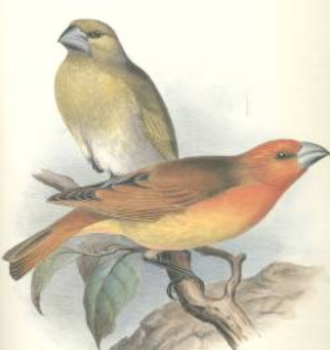
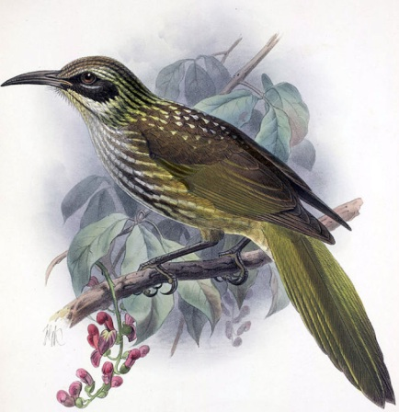
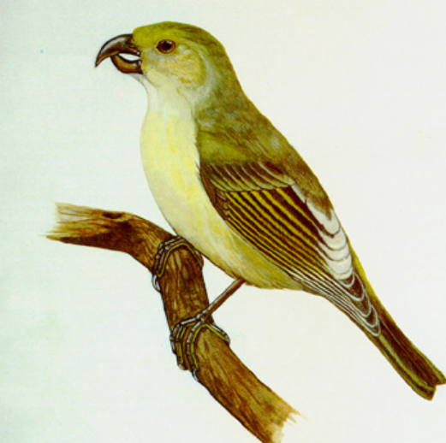
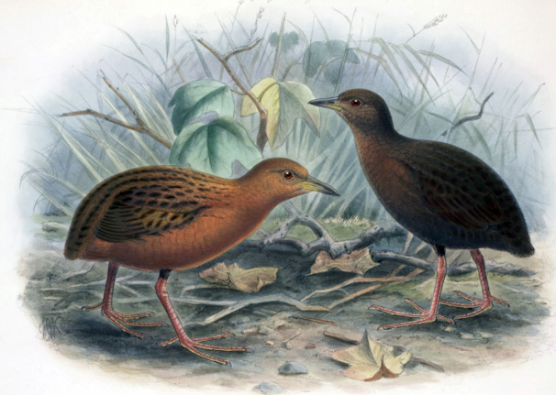
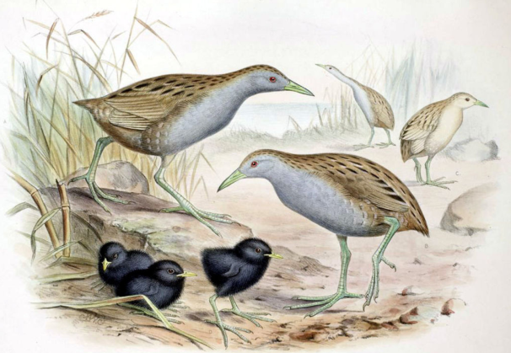
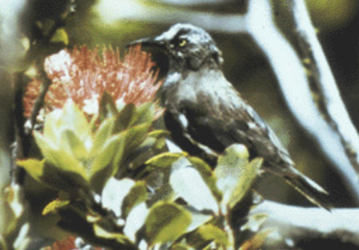
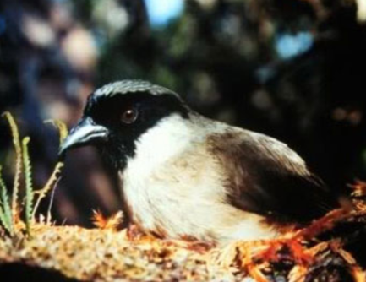
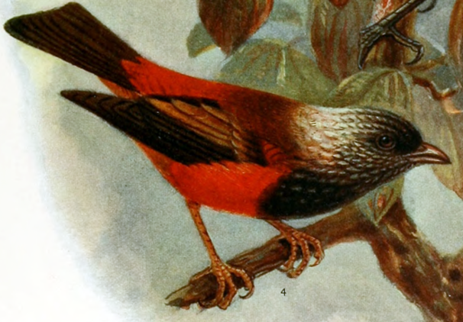
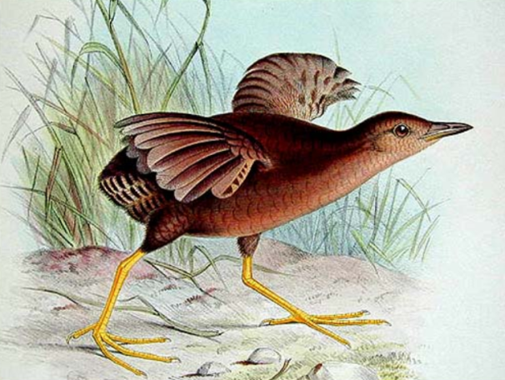
…extinction is happening…
Hemignathus ellisianus, extinct 1940
Hemignathus obscurus, extinct 1940
Rhodacanthis flaviceps, extinct 1921
Moho apicalis, extinct 1837
Himatione sanguinea, extinct 1923
Myadestes myadestinus, extinct 1989
Psittirostra psittacea, extinct 1987
Drepanis pacifica, extinct 1898
Drepanis funerea, extinct 1907
Chloridops kona, extinct 1894
Moho bishopi, extinct 1904
Hemignathus sagittirostris, extinct 1901
Acrocephalus familiaris, extinct 1923
Hemignathus ellisianus, extinct 1965
Moho nobilis, extinct 1934
Myadestes lanaiensis, extinct 1980
Chelychelychen quassus, extinct 1980
Chaetoptila angustipluma, extinct 1859
Rhodacanthis palmeri, extinct1896
Dysmorodrepanis munroi, extinct 1918
Porzana sandwichensis, extinct 1883
Porzana palmeri, extinct 1944
Moho braccatus, extinct 1987
Ciridops anna, extinct 1892
Melamprosops phaeosoma, extinct 2004
Porzana sandwichensis, extinct 1893
Around the world, some 20,000 species are gone a year (Mora et al. Science 2013)
Creative Commons Photos Wikipedia

Slide 13
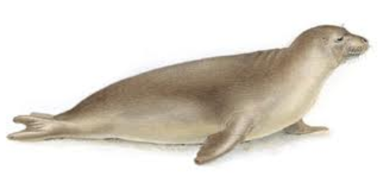
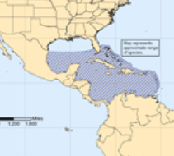
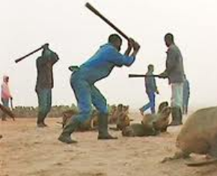
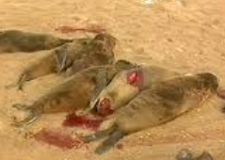
…extinction presentations…
A tail of extinctions: Caribbean Monk Seal (Monachus tropicalis)
Discovered during Christopher Columbus' second voyage to the New World in 1494. Population estimated at 250.000 individuals
The last confirmed sighting in 1952, protected by law in 1967, declared extinct in 2008
Killed mainly for their blubber, which was processed into oils, used for lubrication, and applied as a coating on the bottom of boats
Wiped out in less than 300 years

Slide 14
GRADING COMPONENTS:
Group film 10%
Presenting “extinction” 10%
Class participation and attendance 30%
Final exam 50%
If you miss more than two lectures, you have to take a write exams like any other class.

